Slide 1
Financial Analysis
SAMPLE FINANCIAL ANALYSIS WITH DEFINITIONS
Preliminary Recommendations

Slide 2
Basic Information
Equipment Overview
Total Tonnage - Use of Cost of Ops Worksheets
Total Square Footage – Use of Cost of Ops Worksheets
Type of Equipment (Unitary/Built Up/VRF)
Type of Current Agreement & Cost
Staffing of the Prospective Maintenance Customer
Has the Prospect Provided Costs for Labor & Repairs?
Has the Prospect Provided Costs for Major Repairs?
Have We Collected Any Utility Bills or Spreadsheet?
Specific Needs, Hurts or Business Objectives?

Slide 3
ASHRAE, BOMA & DOE
What is “Simple Benchmarking”?
Descriptions
Calculations & Formulas
Websites
Industry Publications
Homework

Slide 4
Basic Information
(4) 20 Nominal Ton HVAC Split Systems
(9) 7.5 – 12.5 Nominal Ton Unitary Split Systems
(4) 3 – 5 Nominal Ton Unitary Split Systems
(2) Hot Water Boilers (3) Circulating Pumps
$9,380 Current Maintenance/Test & Inspect Contract
$18,312 Unanticipated Major Repairs, Components Replaced
$19,777 Labor & Repair Costs, Emergency Service
Approximate $87,000 Electric Billing @ $.09/KWH?
Responsiveness & Reduced Operating Costs a Priority!
A proactive approach to both maintenance and CEP*

Slide 5
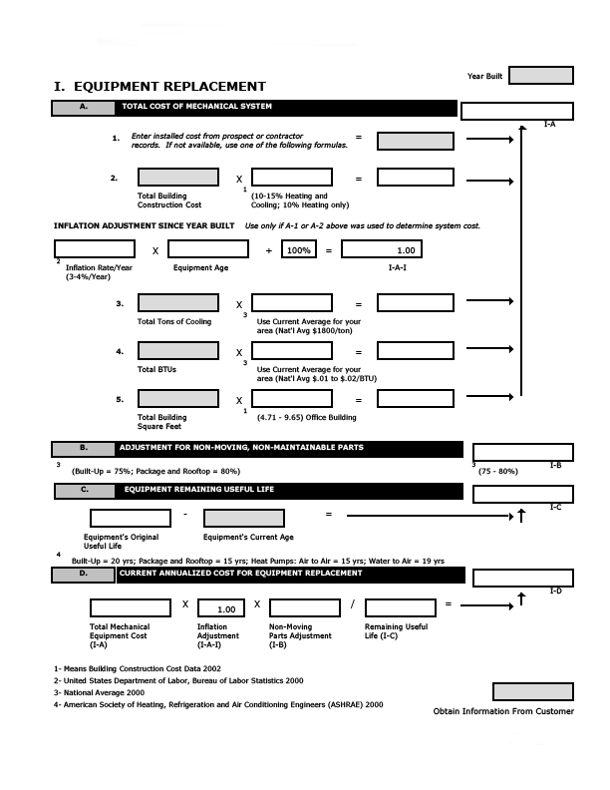
North Boundary $ Worksheets

Slide 6
Energy Savings Calculations
The total electric or utility bill annually less non-HVAC equipment usage – electricity dedicated to HVAC only:
Office Buildings – Up to 55% - 65%
Education Facilities – Up to 45% - 50%
Hospitality/Government/Worship – 45% to 50%
Healthcare Facilities – Up to 45%
Mixed Use/Industrial – Up to 40%
Full Industrial use the numbers from the worksheets that would be derived from square footage

Slide 7
Potential Energy Savings
Energy Savings Example based on total tonnage or provided:
Converting from Test Check & Inspect to Preventive Maintenance Tasking = 14% - 27% Energy Savings (are coils clean?) of HVAC usage
$87,000 Annual Electric Bills
We know according to ASHRAE and BOMA that about 45% goes to HVAC, the balance for operating the church
45% of $87,000 = $39,150 (and with 14% Savings)
14% of $39,150 = $5,481 (Median savings from cleaning of both condenser and evaporator coils, proactive tasking (clean, calibrate, tighten, adjust; pleated filters)

Slide 8
Major Component Replacement
Use actual numbers provided by the prospect for a recommended period of three to five years
Us the North Boundary Worksheets
ASHRAE & BOMA and experience indicate that major repairs and major component replacement costs can be reduced (or cut) by 40% when moving from reactive to proactive maintenance tasking
By analyzing the costs firsts to determine what HVAC costs are repair related and primarily labor vs. major component or major parts repairs we can separate major repair costs from Annual Labor/Outsourced Labor Costs

Slide 9
Major Component Replacement
Under certain contracts, the cost of replacing major components such as compressors and even coils is an annual cost that can be calculated or documented. Actual numbers are given below:
Average Annual Major Component Replacement costs equal $18,312 for years 2017-2020. By purchasing customized maintenance that incorporates proper cleanings, test, check and inspect, diagnostics and filter changes, these costs can be cut by at least 40% (ASHRAE), as well as, extending the useful life.
Cost avoidance would be realized with proper tasking, cleanings, diagnostics/trouble shooting and documentation equal to 40% of $18,312 = $7,325.

Slide 10
Annual Labor & Repair Costs
Outsourced Labor Costs
Annual Labor & Repair Costs can be reduced by half when proactive, comprehensive tasking hours are incorporated into a Customized Maintenance Agreement. Coil Cleanings, Lubrication, Adjustments and Calibration with Refrigerant Charge Diagnostics hours allow for these savings.
ASHRAE/BOMA Data explains that 50% of the annual labor, repair and emergency service can be projected based on maintenance services tasking and documentation. A history of the maintenance tasking also provides a more predictable approach. 50% of the annual costs of repair labor and emergencies (2017-2020) $19,777 = $9,889

Slide 11
EXAMPLE Financial Analysis
Typical Savings Based on Industry Averages
Our Program Costs:
CPM $17,800
$81,519
$10,987
$9,888
$00
___________________
$120,194
Custom Preventive Maintenance Savings $14,275
Current costs:
Electric $87,000
Major Components $18,312
Outsourced Labor $19,777
Current Contract* $9,380
_________________________ $134,469
*Current test, check and inspect

Slide 12
Financial Analysis

